Slide 1
Explainable and Usable AI
CS 344 2022-04-20

Slide 2
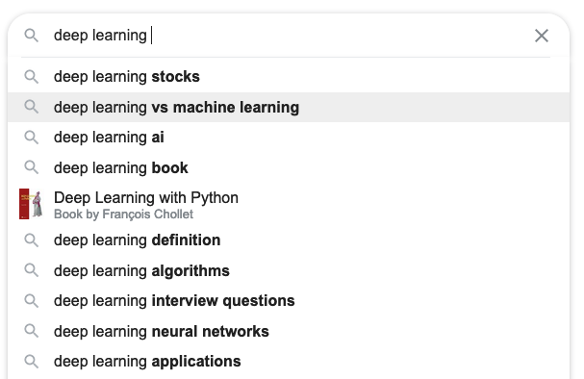
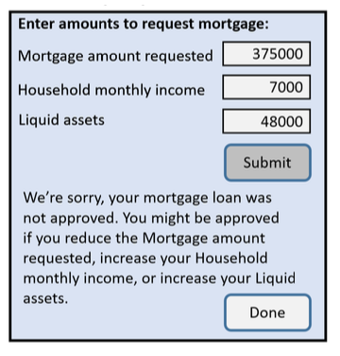

Slide 3

Explain Your Decisions
Likely to get arrested again in next 2 years?
Positive or Negative Review?
Dog or Cat?
all the amped up tony hawk style stunts and thrashing rap-metal can't disguise the fact that, really, we've been here, done that.
The defendant is a Male aged 38. They have been charged with: Battery. This crime is classified as a Misdemeanor. They have been convicted of 0 prior crimes. They have 0 juvenile felony charges and 0 juvenile misdemeanor charges on their record.
Sources: Review: example from https://demo.allennlp.org/sentiment-analysis/roberta-sentiment-analysis. Recidivism: Random sample from Broward County, Florida records from 2013 and 2014, based on data acquisition and analysis by ProPublica, displayed as in Dressel and Farid 2018 https://www.science.org/doi/10.1126/sciadv.aao5580. Image: https://www.boredpanda.com/puppy-looks-like-cat-dog-hybrid/

Slide 4
Main Points
Explainable ≠ interpretable
Models don’t have to be black-box to be accurate.
“Amplify, Augment, Empower, and Enhance People” (-Shneiderman)

Slide 5
Why care?
harms when systems aren’t reliable, safe, trustworthy
benefits when systems empower people

Slide 6
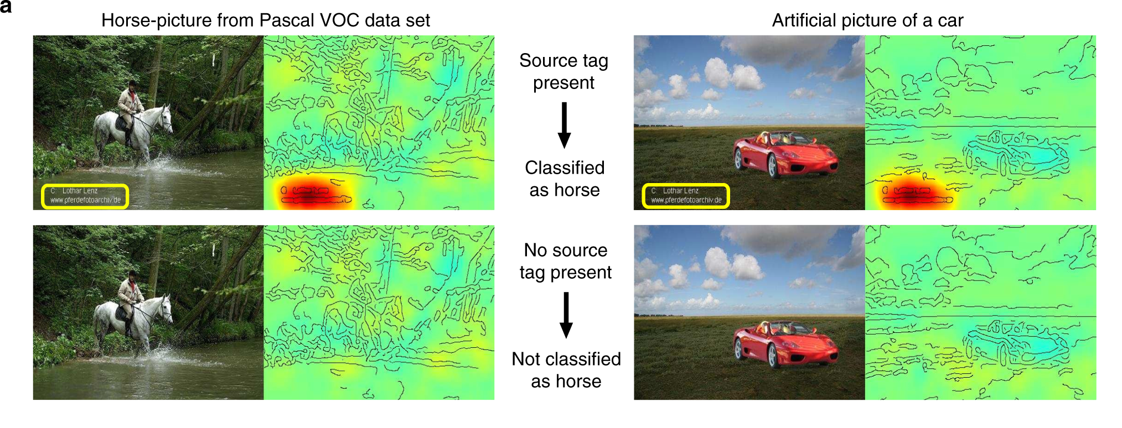
Lapuschkin et al. 2019. Unmasking Clever Hans predictors and assessing what machines really learn

Slide 7
Some Interpretable Models
All examples from Rudin et al. 2020, Interpretable Machine Learning: Fundamental Principles and 10 Grand Challenges

Slide 8
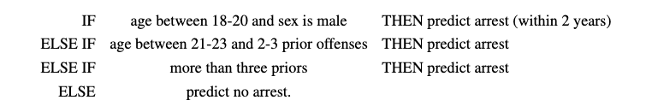
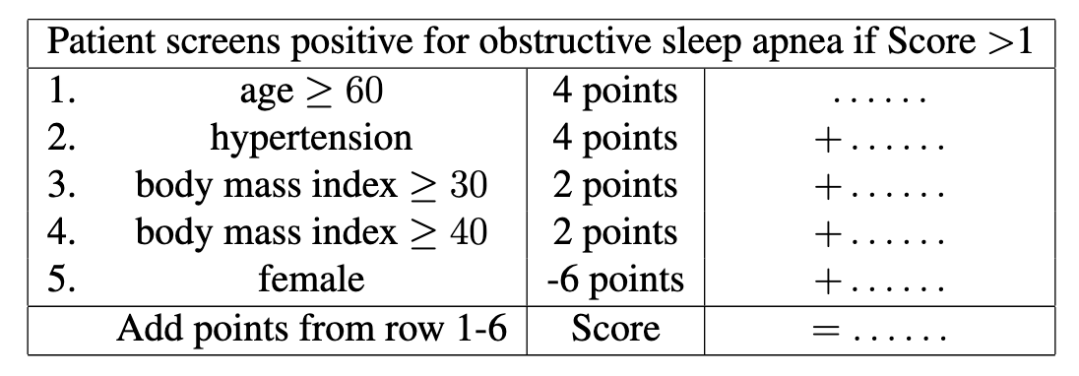
Rule lists and scoring systems
Angelino et al. 2017. Learning Certifiably Optimal Rule Lists for Categorical Data

Slide 9
Generalized Additive Models (GAM)
Score: risk of having diabetes.
plasma glucose concentration after 2 hours into an oral glucose tolerance test

Slide 10
Prototype-based, part-based

Slide 11
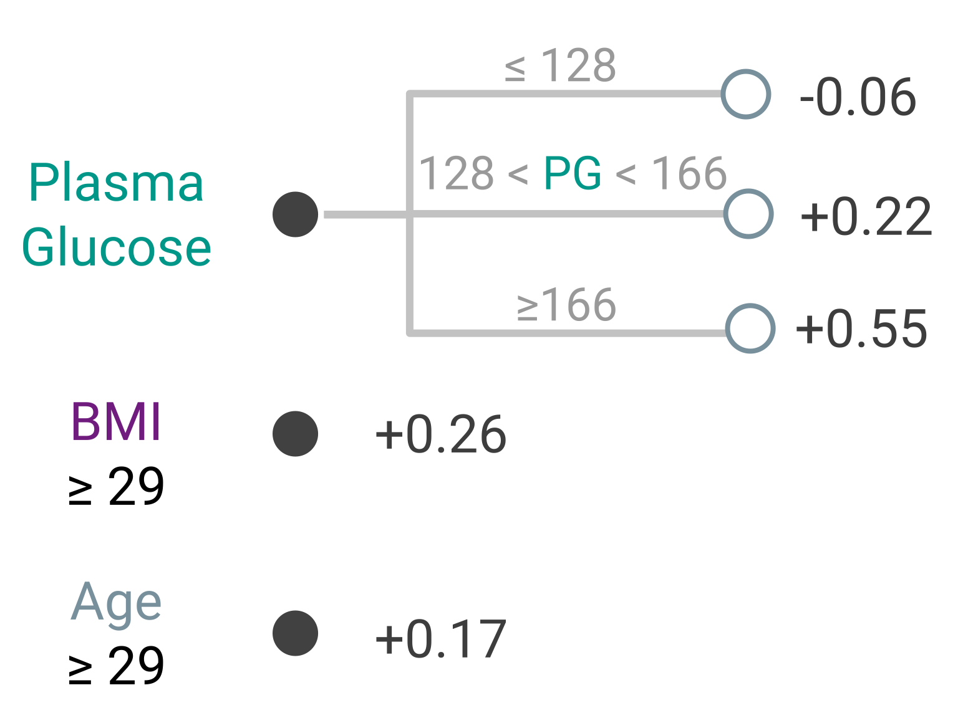
Sums of Trees
Diabetes
Fast Interpretable Greedy-Tree Sums (FIGS)
Go through each tree independently
Sum the outputs of each tree
Interpretable: each tree can be shallow.

Slide 12
What if we need a black box model?
Can we “explain” such a model?

Slide 13
Dimensionality Reduction

Slide 14
Chefer et al. 2021, Transformer Interpretability Beyond Attention Visualization

Slide 15
Other ways to interpret

Slide 16
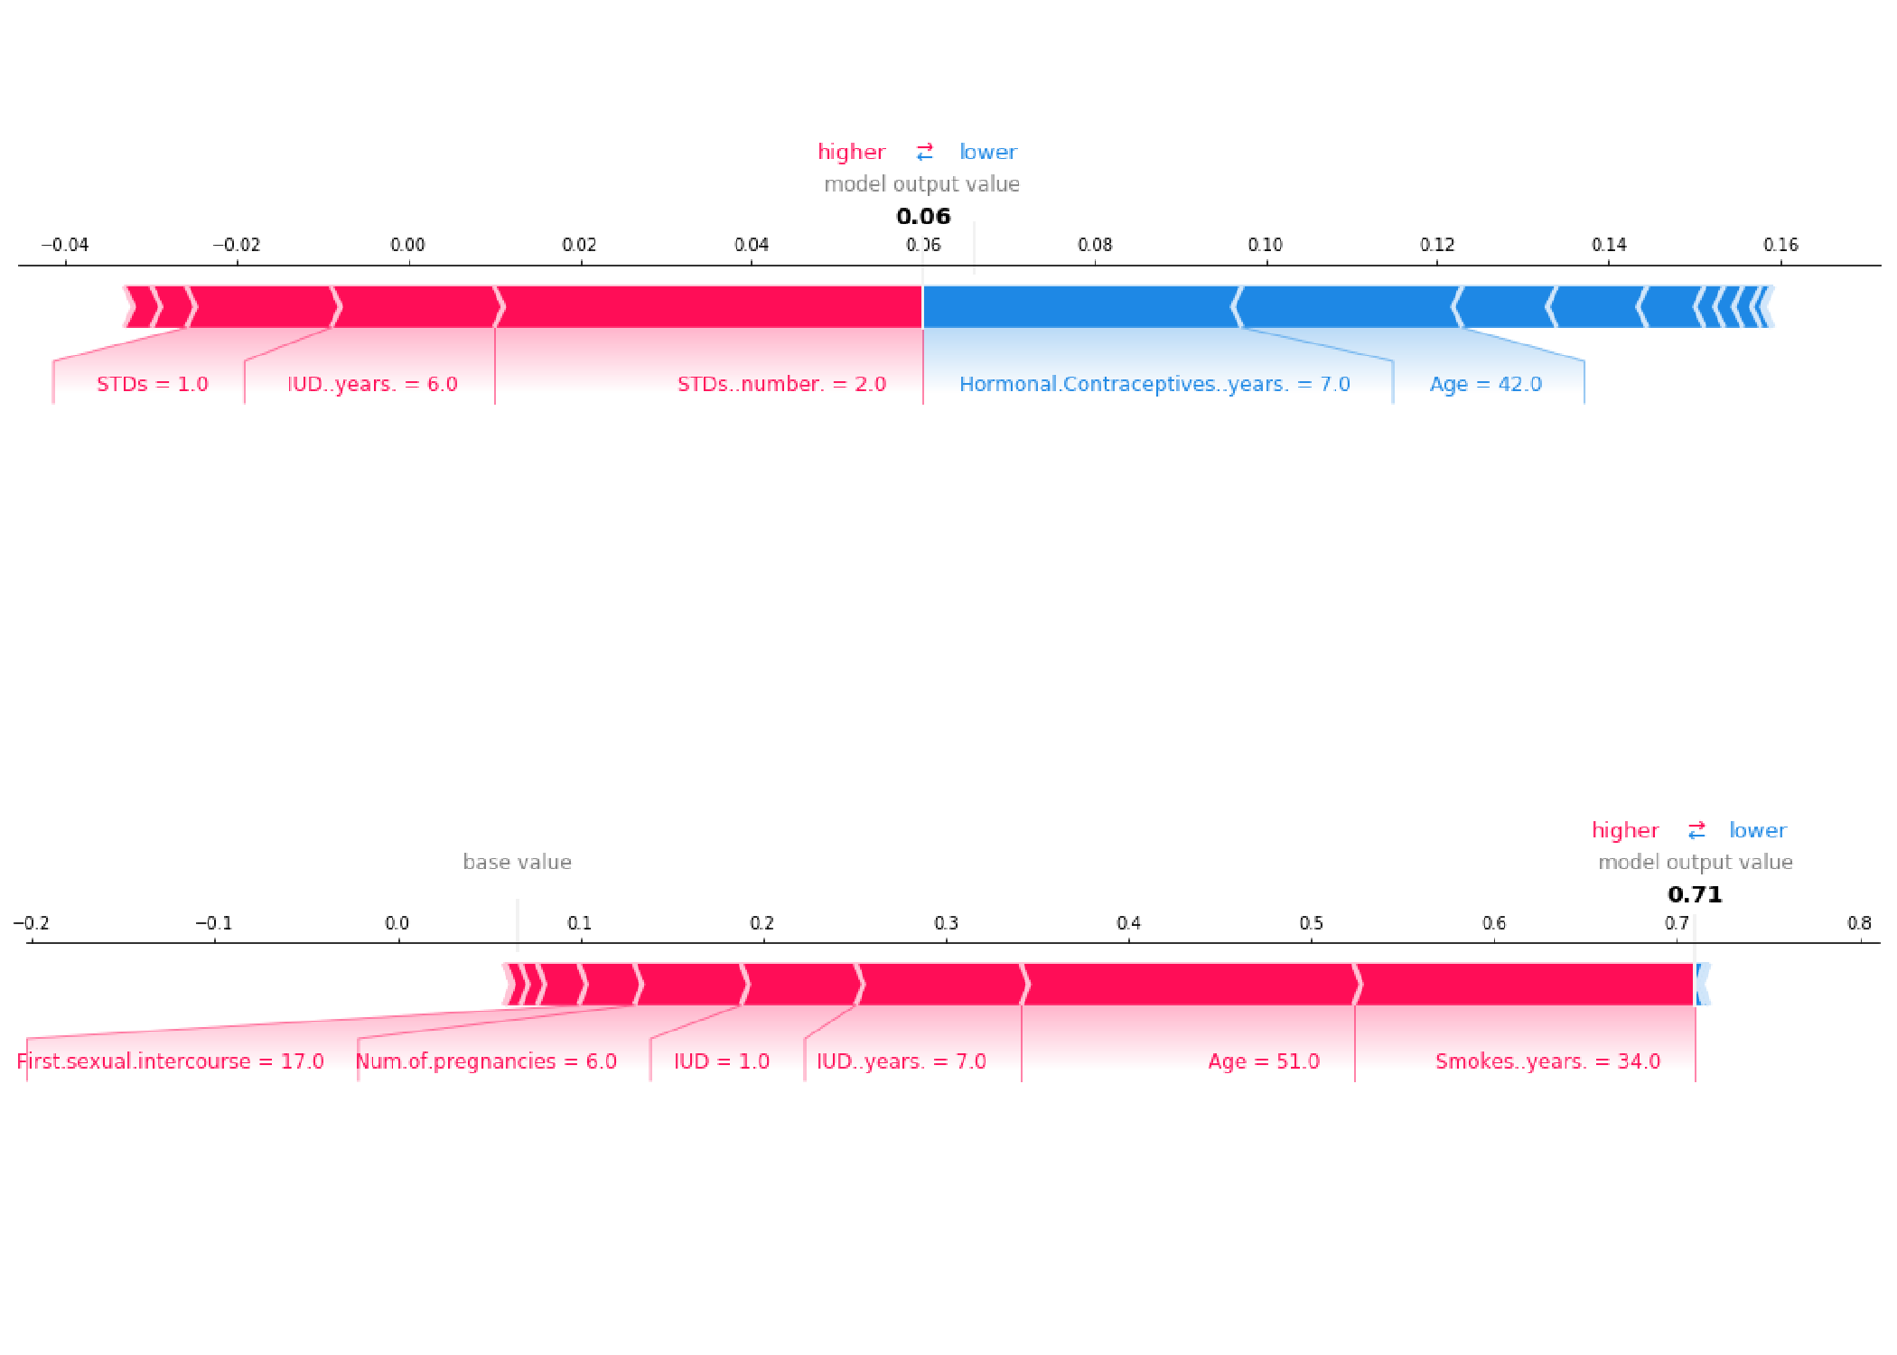
Shapley Values for Explaining Predictions Intuition: average effect of having that feature vs leaving it out
SHAP values to explain the predicted cervical cancer probabilities of two individuals
Source: https://christophm.github.io/interpretable-ml-book/shap.html

Slide 17
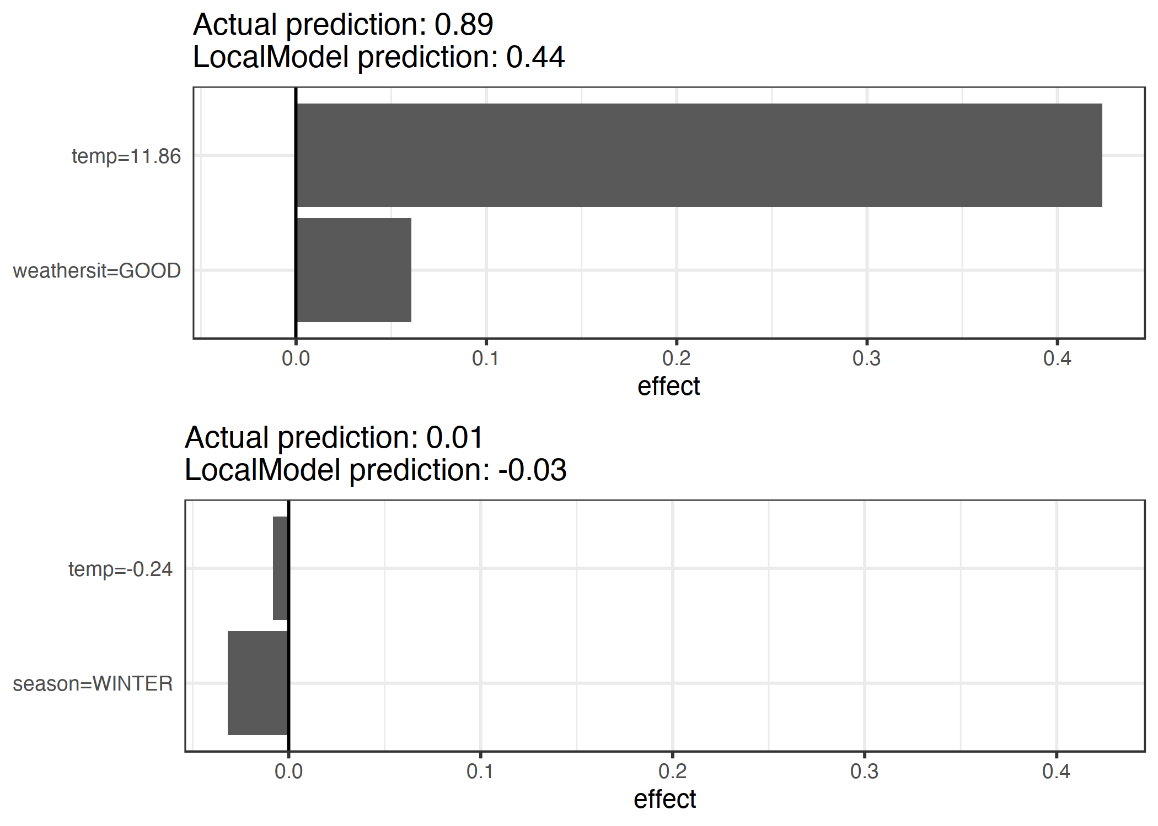
Local Interpretable Model-agnostic Explanations Intuition: fit a simple model in the “neighborhood” of an example
Example: predict if a day will have more or fewer bike rentals than average
Main model: random forest
Surrogate model: logistic reg, 2 features
https://christophm.github.io/interpretable-ml-book/lime.html

Slide 18
Explainable vs Interpretable
Explainable: why did the black box model gave us this answer?
Interpretable: the model isn't a black box

Slide 19
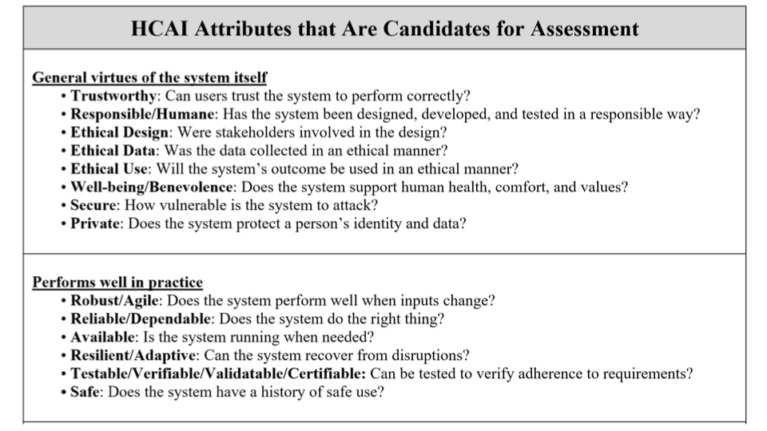
Ben Shneiderman – HCAI Tutorial at ACM IUI 2021 - https://iui.acm.org/2021/hcai_tutorial.html

Slide 20
